Slide 1
HF Monitoring Tools’ Analysis
&
Strategy

Slide 2
Objective
Review, assess & document existing inventory of tools for monitoring, reporting, and, alerting capabilities. Identify gaps and priorities based on team view. Propose both vendor agnostic as well as vendor specific solutions.

Slide 3
Assessment of Current Tools Set
Multiple monitoring tools
Each tool addresses one or more monitoring
requirement and one or more area of interest

Slide 4
Assessment of Current Tools Set
Monitored Platforms
x86_64 servers
AS/400 iSeries
Windows servers
Virtual environment
Databases
Database servers
Email systems
Active Directory
Networking equipment

Slide 5
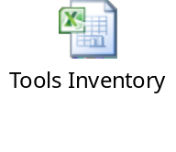
Assessment of Current Tools Set
List of Tools

Slide 6
Assessment of Current Tools Set
What are the issues…..

Slide 7
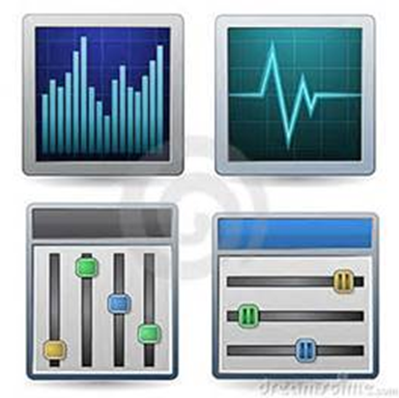
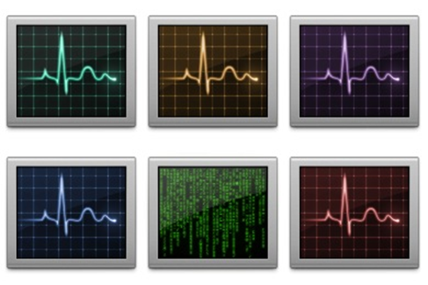
Assessment of Current Tools Set
Silo Style Monitoring
        Separate events’ data streams from a host of monitoring tools resulting in multiple web pages or windows to view information

Slide 8
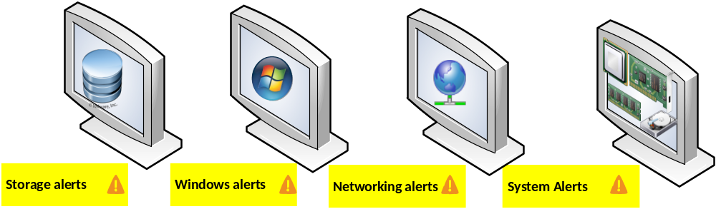
Assessment of Current Tools Set
      Problems are reported at the hardware or component level giving a limited picture of the problem

Slide 9
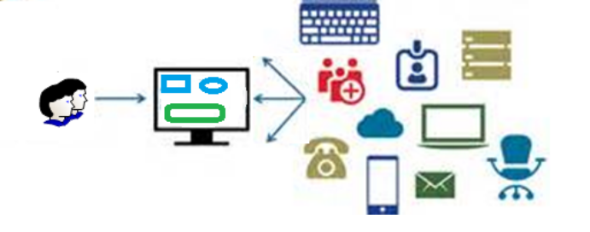
Assessment of Current Tools Set
No single pane of glass view to show
performance and health of business
applications and IT systems

Slide 10
Assessment of Current Tools Set
Information Glut
      The sheer volume and frequency of monitored events or alerts make it extremely difficult to relate events’ data to a developing business impacting situation
      Reactive Response
      Difficult triage management

Slide 11

Assessment of Current Tools Set
  Volumes of disparate data does not help in RCA especially in the presence of multiple upstream and downstream impacting applications

Slide 12
Assessment of Current Tools Set
  Issues for IT Staff
  18 different tools producing 18 different information streams to look at
      Support staff cannot possibly eyeball hundreds of alerts and emails
    Response is reactive
      Resource allocation is un-optimized

Slide 13
Future State
IT Operational Intelligence
Not
System Monitoring

Slide 14
IT Operational Intelligence
IT operational intelligence is about moving away from silo style bottom up system level monitoring of IT systems to business and datacenter centric view of entire IT landscape
IT Operational Intelligence is achieved using IT Operations Analytics (ITOA) tool(s)

Slide 15
IT Operations Management
IT Operations Analytics is a process along
ITOM maturity curve
  IT Operational Analytics ITOA
    Practice of monitoring, gathering, processing, analyzing and interpreting data from various IT operations sources to guide decisions and predict potential issues http://searchitoperations.techtarget.com
    ITOA is datacenter driven not tools driven
  IT Operations Management = ITOA + Datacenter Level Management of Infrastructure (Management of Compute, Storage, Networking, and Application systems)

Slide 16
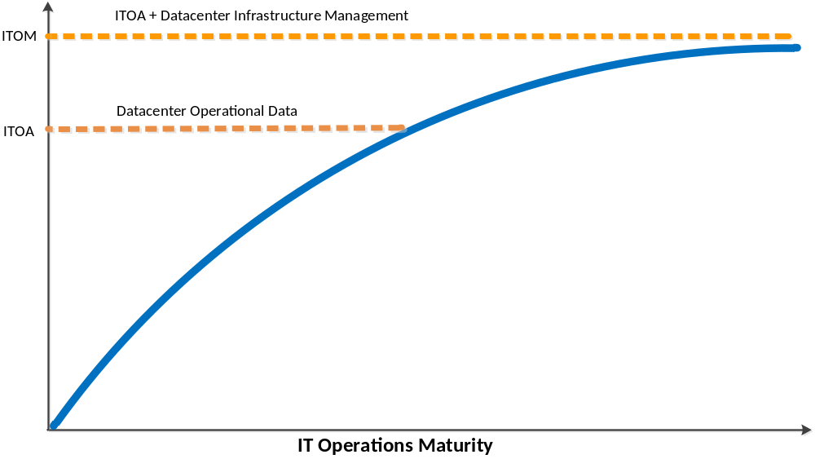
IT Operations Management ITOM
ITOM is an IT Operations Maturity Curve

Slide 17
Future State – ITOA
ITOA will be the first step to achieve IT Operations Maturity leading to ITOM

Slide 18
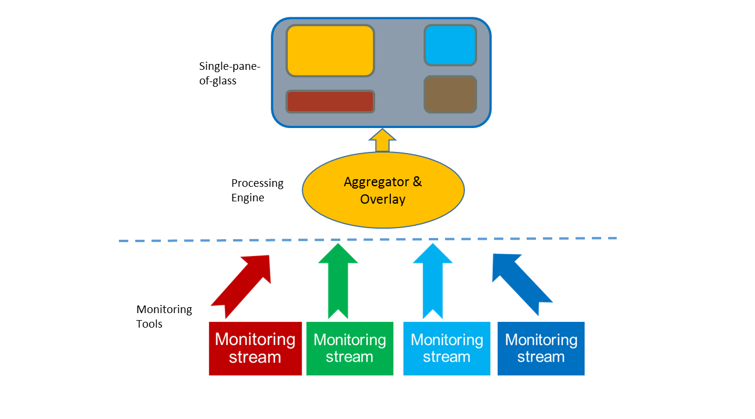
Future State – ITOA
An ITOA capability could instrument data streams form different monitoring tools into a single-pane-of-glass management view and dashboards
Aggregator & Analytics Tool

Slide 19
Future State – ITOA
Required Qualities in ITOA Tools/Capability

Slide 20
Required Qualities
Service/Application Monitoring
  Must be able to receive data streams from all
  of the HF system monitoring tools and provide a
  management interface and means to
  correctly and accurately prioritize response
  to a business impacting situation before
  business service is affected.

Slide 21
Required Qualities
Service Measuring
  Must be able to measure service level quality and track business performance against established SLA’s
  Integrate Incident Management to relate reported issues with system health and system performance
  Provide custom dashboards to LoB managers to view performance in near-real time and in historical perspective

Slide 22
Required Qualities
Benefit of Service Measurement
Effective communication with LoB stakeholders by means of Business Value Dashboards (BVD’s) i.e. custom dashboards according to business view points

Slide 23
Required Qualities
Service Mapping
  Tool must be able to receive all data
  streams form monitoring silos and
  automatically build a service-model view of
  the environment by leveraging a CMDB
  and should be able to automatically discover
  and synchronize changes in the
  infrastructure landscape.

Slide 24
Required Qualities
4. KPI’s and SLA’s
ITOA tools should provide these KPI’s:
Reduction in Service Impacting Events (%age or number)
Reduced MTTR (%age or number)
How many business processes (e.g. transaction and/or cases) completed in 1 Hr., 2 Hr. etc.
How many incidents reported before a condition was addressed? Zero or a low # of incidents is desirable

Slide 25
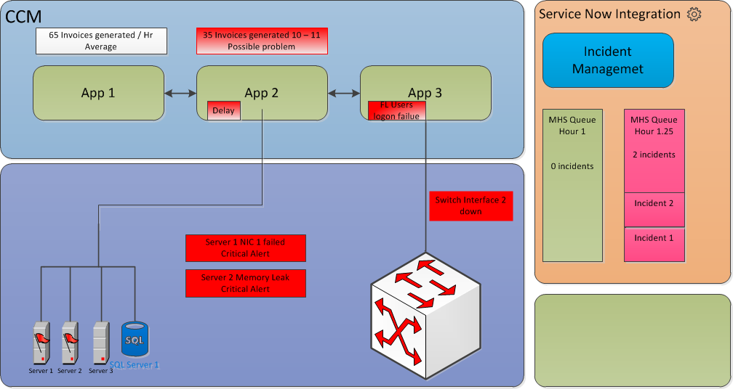
Required Qualities
How IT Operational Intelligence Tool Capability Can Help in RCA and Relate Problems:
CMS comprised of 3 apps
At Hr. 1 problem reported in App 2. Drill down show NIC 1 failure on server 1 and memory leak on server 2.
NIC failure had no effect because of NIC teaming. IT replaced NIC and DevOps team fixed memory leak.
Zero incidents reported in SNOW.
However, two incidents reported at Hr. 1.25 b/c memory issue was not resolved quickly enough making application non-responsive

Slide 26
Industry Direction
Monitoring has undergone a paradigm shift in that IT needs to provide Operational Intelligence to both IT and business leaders across all technology silos to improve IT Operational Performance to directly impact business value streams

Slide 27
Industry Direction
Industry is moving to analyze swaths of data produced by different technology layers to provide insight into system health, performance, proactive problem resolution and shorter RCA. This is an IT BigData problem which needs BigData Analytics tools to sift though vast amounts of data to provide operational intelligence across all technology silos.

Slide 28
Industry Direction
Gartner recommends these approaches for the IT leadership:
Application Performance Management (APM) Tools
  To manage and monitor software application through all touch points from Mobile device/Client browser through Web tier, Application tier, Network, Middleware, and Databases tiers
Business Value Dashboards BVD
  To provide business metrics reporting
IT Operational Analytics ITOA
  To Provide Operational Intelligence and Performance Improvement – IT BigData approach to analyze data for operational improvement
Network performance Monitoring and Diagnostics NPMD
  To understand performance of application, network, and infrastructure stacks using network instrumentation

Slide 29
Tools Selection
Vendors provide ITOA tools in different
flavors and combinations. There is no single tool that can provide systems, network and application operations analytics in an atomic out of box configuration

Slide 30
Tools Selection
Most vendors provide ITOA tools in the form of an standalone Aggregator & Overlay tool plumbed with their own or 3rd party monitoring tools or provide a complete ITOA product suite
  This is analyzed in the accompanying spreadsheet

